Slide 1



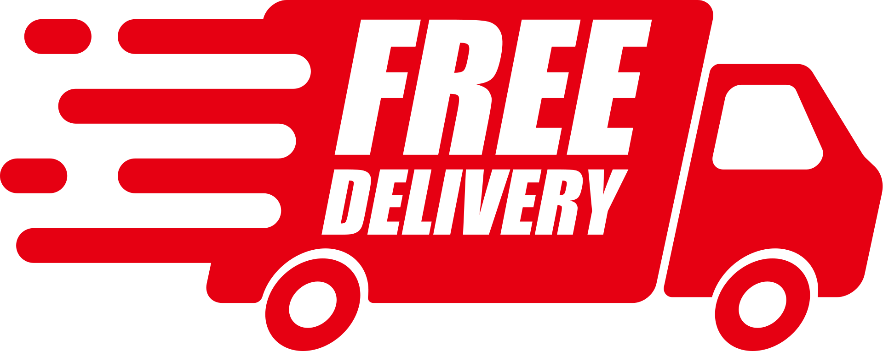




Data Analytics
ZOMATO
CASE STUDY
Presented By - Mohi Gupta

Slide 2





Topic
Outline
Introduction
Problem Statement
Stakeholders
Data Insights
Looker Studio
Dashboard

Slide 3





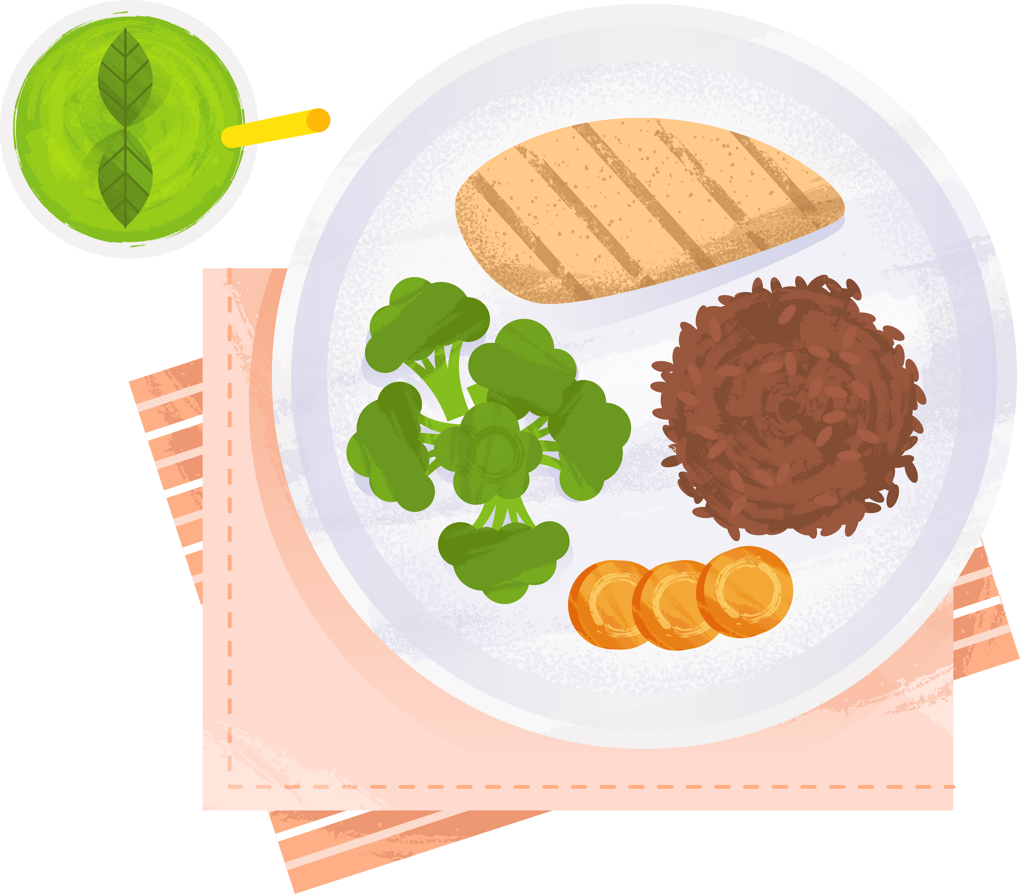
Zomato, a top food delivery platform in India, is facing key challenges such as decreasing customer satisfaction, variable delivery times, and uneven sales across different regions. As members of the analytics team, our goal is to extract meaningful insights from customer orders, restaurant reviews, and delivery metrics to support Zomato in enhancing customer loyalty, streamlining operations, and achieving long-term growth.
INTRODUCTION

Slide 4


PROBLEM STATEMENT
Key Issues
Why are customers leaving?
What is causing delivery delays and order cancellations?
Impact
Reduce customer lifetime value and loss of market share

Slide 5



MISSION & VISION
STATEMENT
Mission
Vision
By analyzing the factors impacting our growth and understanding the root causes of customer dissatisfaction, we can develop focused strategies to elevate our services, optimize operations, and enhance the overall customer experience, leading to long-term, sustainable growth
Our goal is to boost customer satisfaction by providing outstanding service, ensuring prompt deliveries, and consistently refining our operations based on customer feedback.

Slide 6
STAKEHOLDERS
Internal
Marketing , Operations , Customer Support , Leadership
External
Customer and Restaurant Partners

Slide 7











Delivery
Customer
STAKEHOLDERS
Delivery Location
Pickup Location
Delivery time
Payment Time
Delivery Fee
Driver name
Driver y_mode
delivery _ root
delivery_traffic
peek_hour
Customer id
Customer name
Customer Location
Customer_location time
Customer_age
Custpmer_rating
Table_booking
Customer_mob
Customer_email
Customer_gender
A stakeholder is any individual, group, or organization that has an interest in or is affected by a company’s operations, decisions, and outcomes. Stakeholders can be internal, such as employees and management, or external, including customers, delivery partners, restaurant vendors, investors, and regulatory bodies. Their involvement is crucial, as they influence strategic direction, contribute to business success, and are directly impacted by the company’s performance.
Order
Restaurant
Order_id
order_location
order_time
Order Frequency
Customer_id
Payment type
Order_hjistory
Restaurant_id
Restaurant_name
Restaurant_picture
Restaurant_address
Restaurant_review
Restaurant_cuisine
Restaurant_ingredient
Customer_service

Slide 8






Visualizations
Total Completed Orders
Average delivery time by city
Most used payment method
Revenue trends over time
Customer rating distribution
DATA INSIGHTS
Operational Insights
Delivery times across statuses
Cuisines types with high delivery times

Slide 9


CONCLUSION
Examining delivery times, order progress, and customer feedback allows us to uncover valuable insights that boost engagement and streamline operations. Tackling these challenges is essential to improving customer loyalty and increasing revenue, ensuring Zomato stays ahead in the competitive food delivery industry.

Slide 10

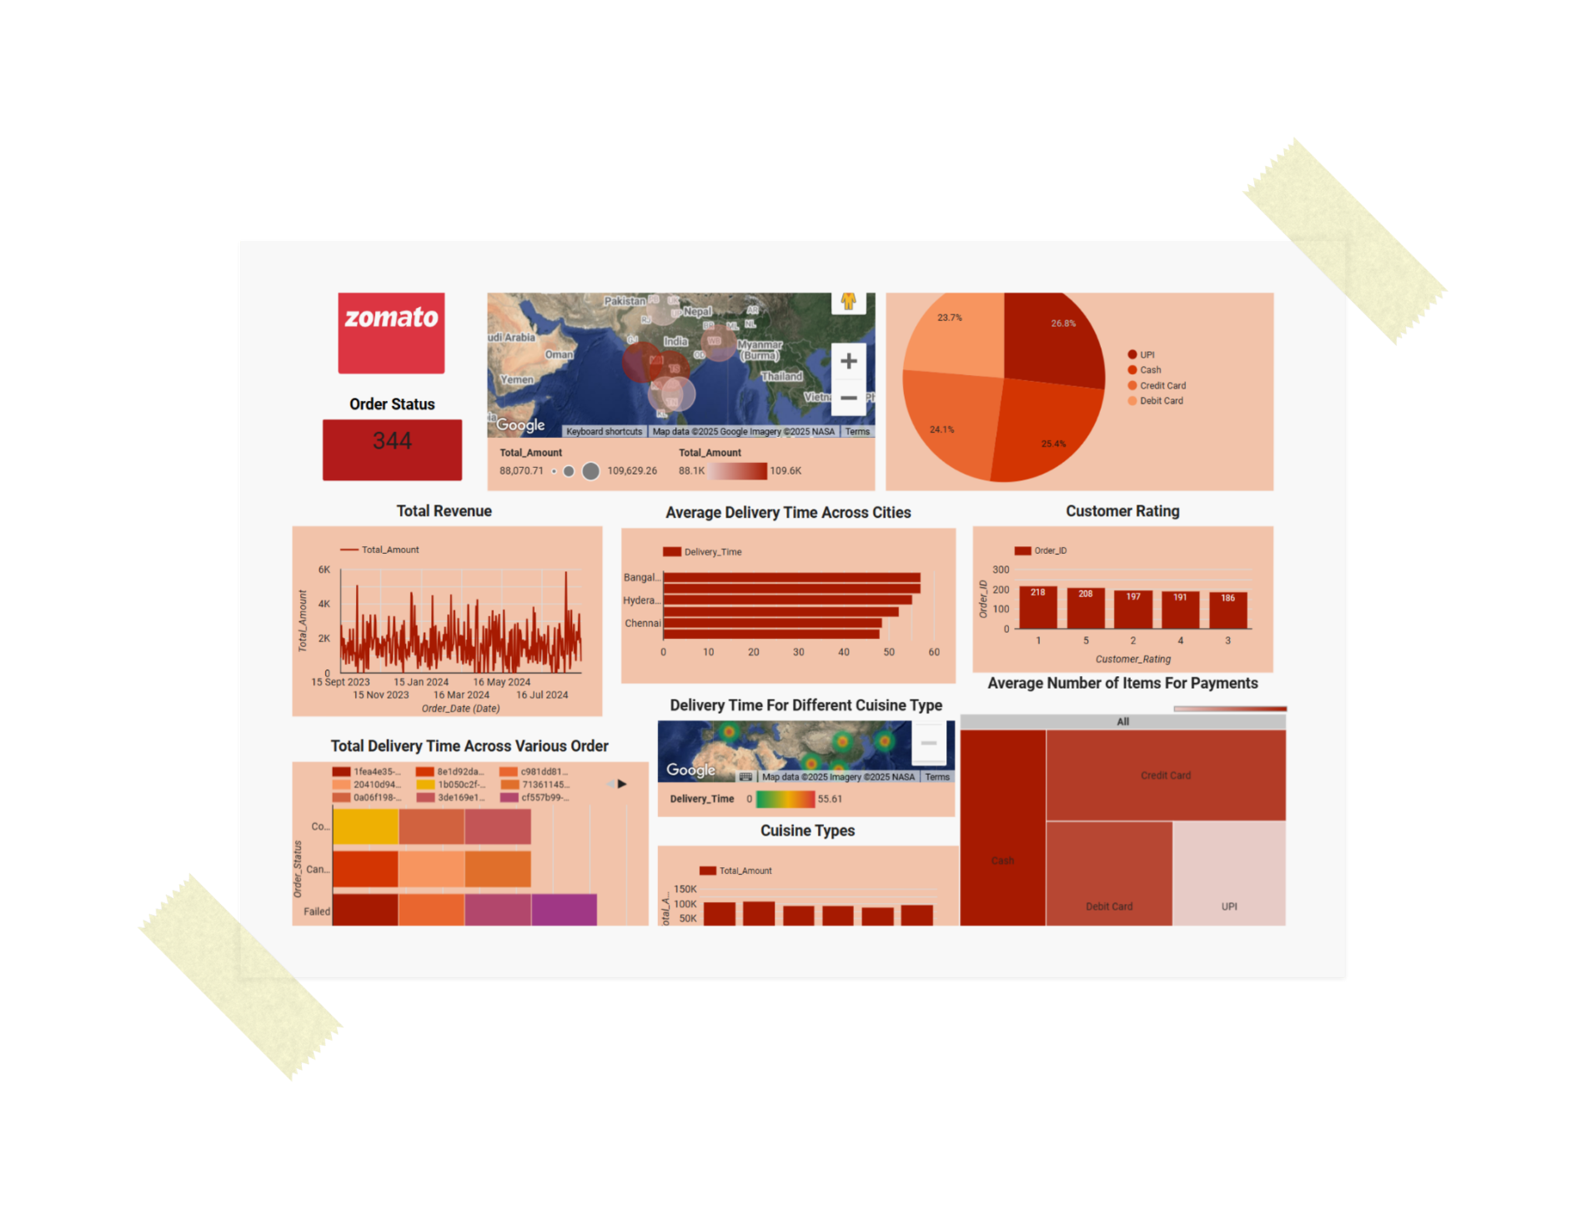

LOOKER DASHBOARD

Slide 11



THANKYOU !
For any suggestions feel free to ask any questions!
Interactive Dashboard
mohi.workspace@gmail.com
LinkedIN

